Slide 1
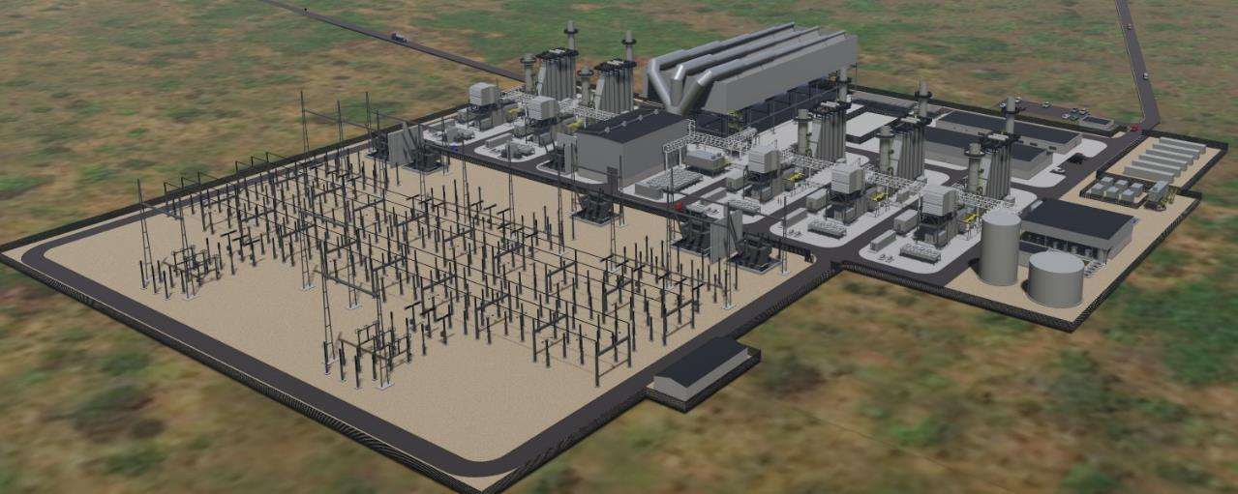
Globeleq and CTT Project Overview
September 2022

Slide 2
INDEX
Globeleq – 20 years of operation
Our Presence
Project Overview
Project Sponsors
What are Working Towards
CTT - Infrastructure Synergies involved in the Project
CTT Development Impact
CENTRAL TÉRMICA DE TEMANE
2
Notes:
JS

Slide 3
I. GLOBELEQ – 20 YEARS OF OPERATION
Globeleq is a leading investor, developer, owner and operator of a diversified energy portfolio in Africa.
Supported by our shareholders, BII – British International Investment and Norfund, Globeleq aims to play a transformational role on the continent by addressing Africa’s need for cost effective power and maximising our positive impact.
Globeleq has nearly 1,500 MW of power generation in operation across 14 projects in 6 countries, with a further 722 MW in construction and >2,000 MW in development.
We have a proven track record of operations and project development since 2002, and support the ongoing development of the African power sector. We work closely with our partners to adapt and respond to their unique needs.
Our in-house teams have extensive experience and networks to implement power solutions across various technologies and geographies to optimise both the technical performance and commercial value proposition for each project.
We can rapidly localize our operations, leveraging our teams to build local capacity as needed. We operate our plants to international performance and safety standards.
3

Slide 4
II. GLOBELEQ - OUR LOCATIONS
London, United Kingdom | Corporate Office
Location Type
Plant Status
Solar
Existing
Lagos, Nigeria | Office
Wind
In Construction
GPSN – C&I| 15 plants - 66 MW
Gas
Abidjan, Côte d’Ivoire| Office
HFO
Azito| 460 MW
Office
Azito 4 Expansion| 253 MW
Cairo, Egypt | Office
ARC | 66 MWp
Malindi | 52 MWp
Dibamba| 88 MW
Nairobi, Kenya| East Africa Office
Kribi| 216 MW
Tsavo | 75 MW
Douala, Cameroon| Office
Dar es Salaam, Tanzania| Office
Songas | 190 MW
Droogfontein | 50 MWp
Soutpan | 31 MWp
Aries | 11 MWp
Maputo, Mozambique | Office
Konkoonsies | 11 MWp
Johannesburg, South Africa | Office
De Aar | 50 MWp
Boshof | 66 MWp
Cape Town, South Africa | Southern Africa Office
Jeffreys Bay | 138 MW
Klipheuwel | 27 MW
4

Slide 5
III. Project Overview
Project Overview
Plant | 450MW combined-cycle gas-fired power plant
Location | Inhambane Province, Mozambique
Project Sponsors | EDM, Globeleq, Sasol
Financial Close | 08 December 2021; Notice to Proceed January 2022
Construction | 34 months
COD | Q4 2024
CTT
Maputo
Project Highlights
Single phase 450MW plant with daily despatch flexibility, supported by detailed market assessment and offering a competitive tariff
Well-structured project financing benefiting from World Bank (“WB”) partial risk guarantee (“PRG”) support and robust contractual risk allocation, including a tolling structure and tested government support package
Strong equity alignment with complementary players, led by power development specialist and including utility off-taker, transmission owner and energy planner as well as gas supplier to ensure value chain alignment
Anchors critical transmission infrastructure which will connect Mozambique’s Southern and Central-Northern transmission systems
Supports the strengthening of the Mozambican government’s balance sheet, as a commercially viable, positive return project
Gas supplier has a proven track record of Mozambican and regional deliveries and upstream field management
Establishes a template project structure for combined cycle power generation in Mozambique and for the region
5
CENTRAL TÉRMICA DE TEMANE
Notes:
JS

Slide 6
IV. Key Project Stakeholders
SPONSORS
DEBT LENDERS
CREDIT SUPPORT
B LOAN LENDERS
6
CENTRAL TÉRMICA DE TEMANE
Notes:
JS

Slide 7
V. What We Are Working Towards
CENTRAL TÉRMICA DE TEMANE
7
Notes:
JS

Slide 8
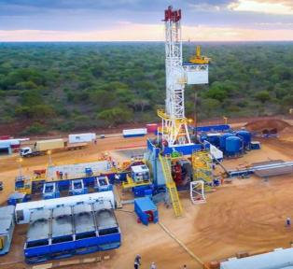
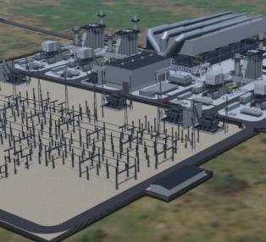
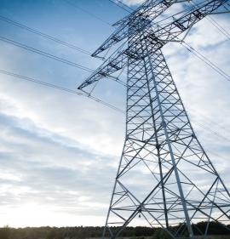
VI. CTT - INFRASTRUCTURE SYNERGIES INVOLVED IN THE PROJECT
Gas Field Development
Temane Power Project
Temane Transmission Project
$760 m in upstream gas infrastructure investment
$650 m in infrastructure investment
$350 m transmission line investment
CTT anchors the establishment of US$ 1.5 Bn + value chain by:
Gas development monetisation
Electricity transmission
8
CENTRAL TÉRMICA DE TEMANE

Slide 9
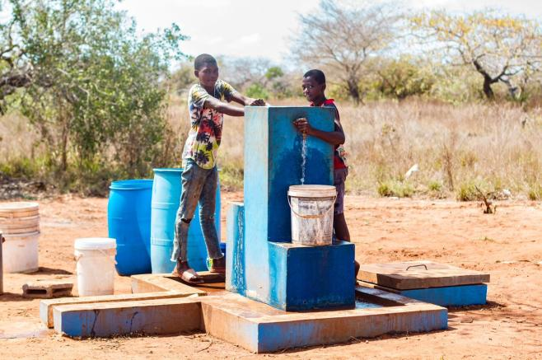
VII. CTT Development Impact
The project will contribute to the creation of more than 700 jobs and the development of the region
CTT is expected to provide electricity to meet the demand of 1.5 million households
It will contribute about 14% of the electricity supply capacity to meet demand in Mozambique
The project is Paris Agreement and will support Mozambique’s longer-term sustainable energy transition to net-zero by 2050
support the country’s economic recovery and the region’s energy transition
It supports the industrialization program launched by the government of Mozambique
CENTRAL TÉRMICA DE TEMANE
9

Slide 10
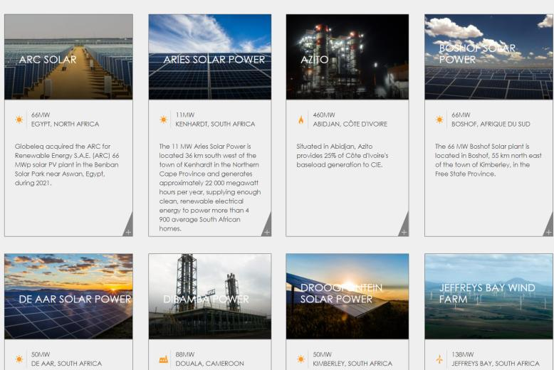
MORE INFORMATION ABOUT OUR PROJECTS: https://www.globeleq.com/

Slide 11
Obrigado!

